Slide 1





Predictions on congestion!
Team BeautifulSoup:
Elena Jiang
Chen Bian
Lanyu Dong

Slide 2





MEET OUR TEAM!
Elena Jiang
Chen Bian
Lanyu Dong
MEM 21fall Student
Data Visualization part
MEM 21fall Student
EDA part
MEM 21fall Student
Machine Learning part

Slide 3


AGENDA
01
VISUALIZATION & INSIGHTS
02
DATA UNDERSTANDING
03
DATA PREPARATION & MODELING
04
EVALUATION & CONCLUSION

Slide 4



1
DATA VISUALIZATION & INSIGHTS

Slide 5
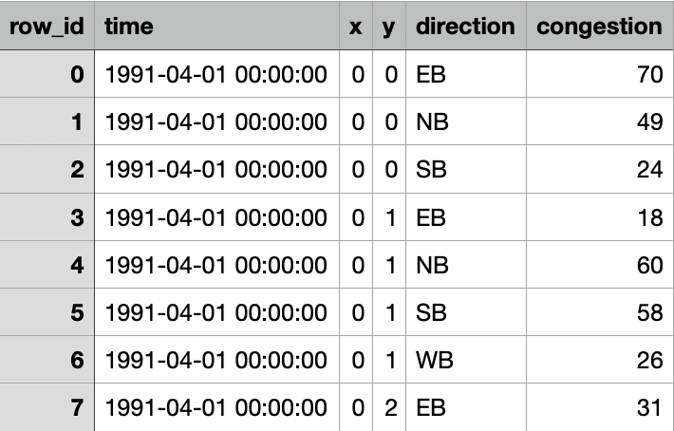

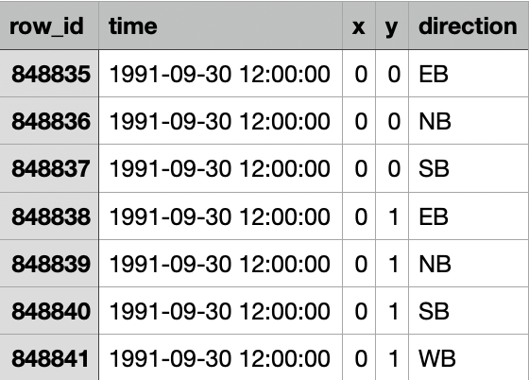
TRAINING DATASET
DATA WE WORKED WITH
ATTRIBUTES
Time - The period when the measurement was taken
x and y - The midpoint coordinate of the roadway
Direction - The direction of the roadway
Congestion - the normalized congestion level of a roadway
TESTING DATASET
TRANING SET
Includes data from April through September of 1991
Number of instances in the training set: 848,834
TESTING SET
Predict hourly congestion level based on location and direction of September 30th, 1991

Slide 6

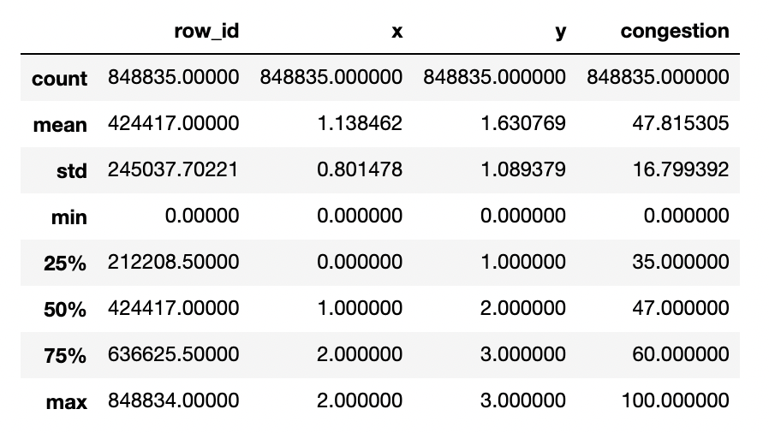
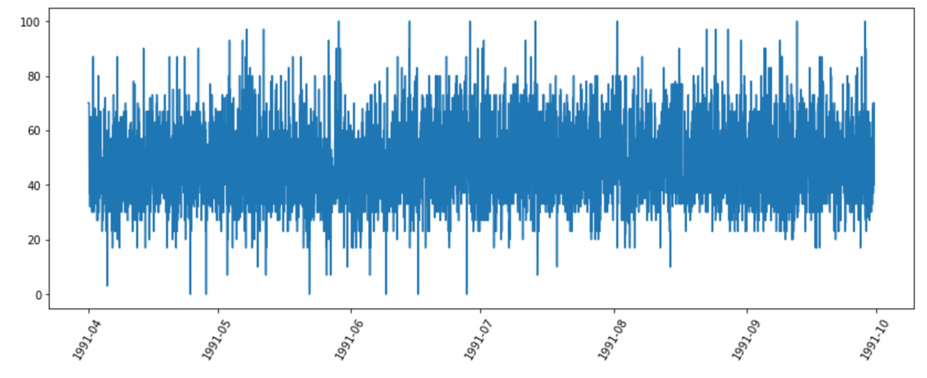
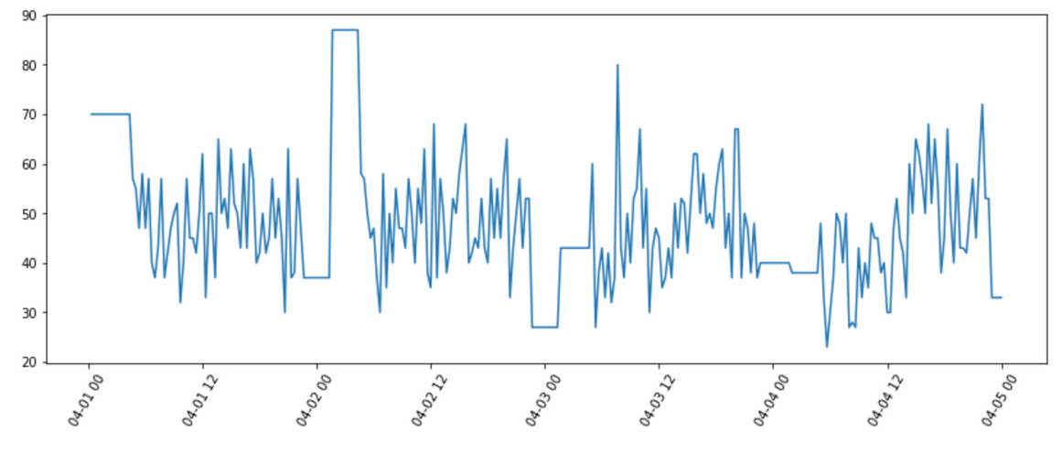
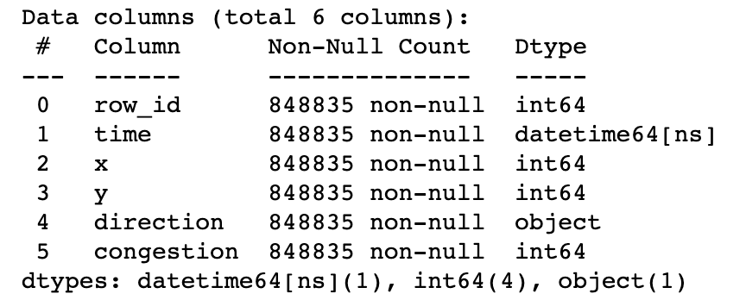
SOME BASIC INFORMATION

Slide 7
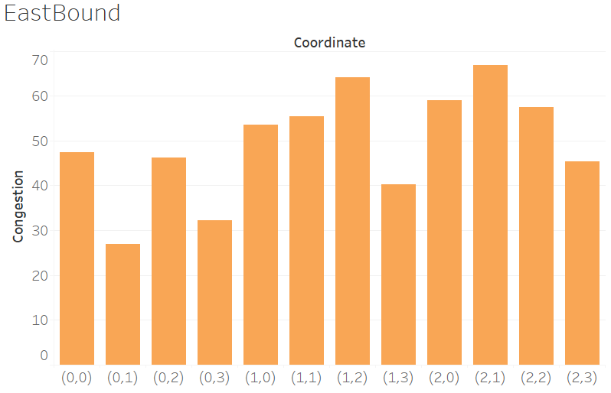
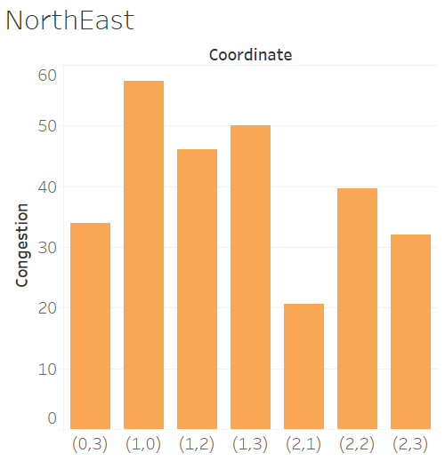
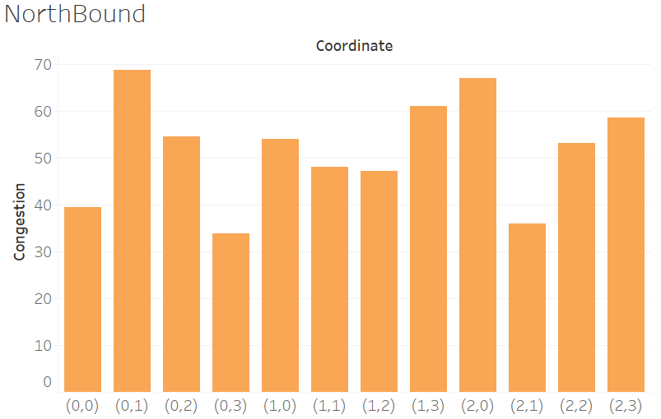
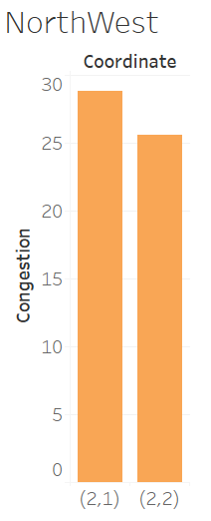
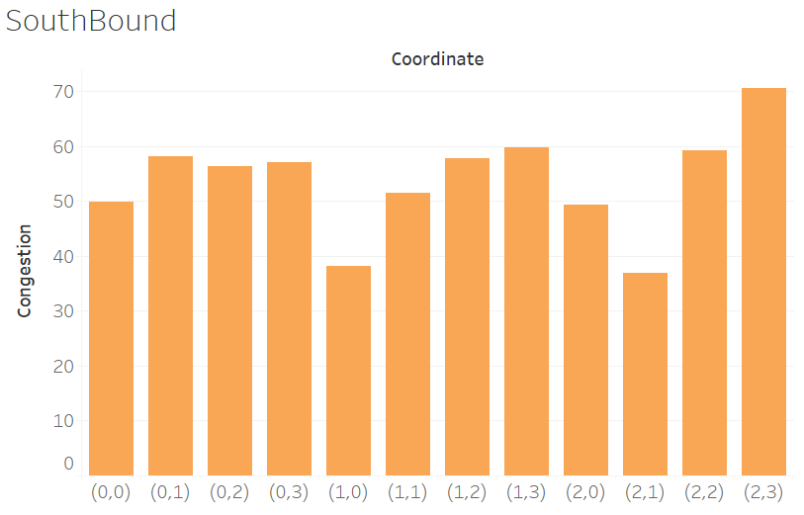
Congestion In Different Directions

Slide 8
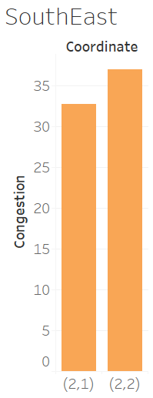
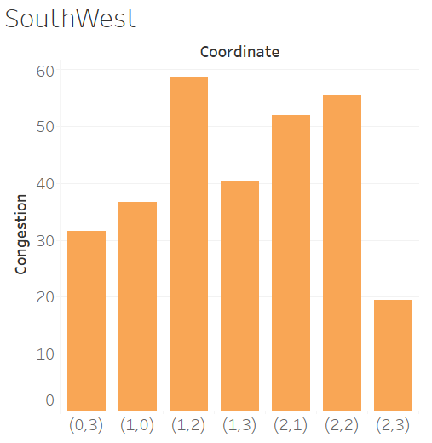
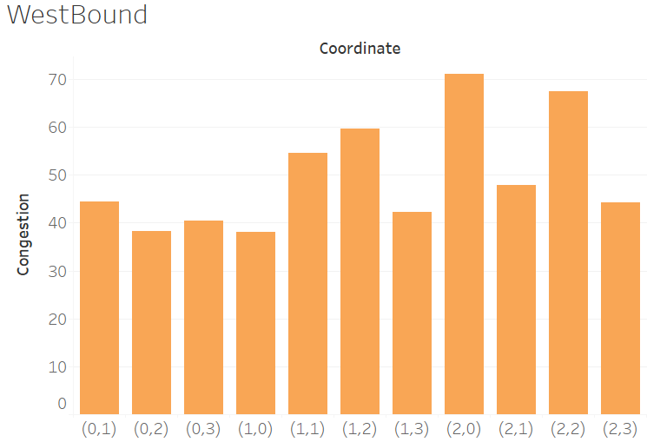
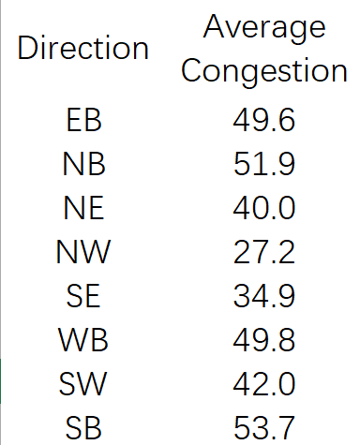
Congestion In Different Directions (Cont.)
CONGESTION LEVELS
Cardinal Directions (e.g. EastBound) have a relatively higher congestion level than ordinal directions (e.g. NotrhEast)
NUMBER OF COORDINATES
Cardinal directions have more coordinates than ordinal directions, indicating more roadways on the cardinal directions.
AVERAGE CONGESTION LEVEL
Highest: Southbound
Lowest: Northwest
HIGHEST & LOWEST CONGESTION LEVEL
Highest: Westbound at coordinate (2,0)
Lowest: Southwest at coordinate (2,3)

Slide 9
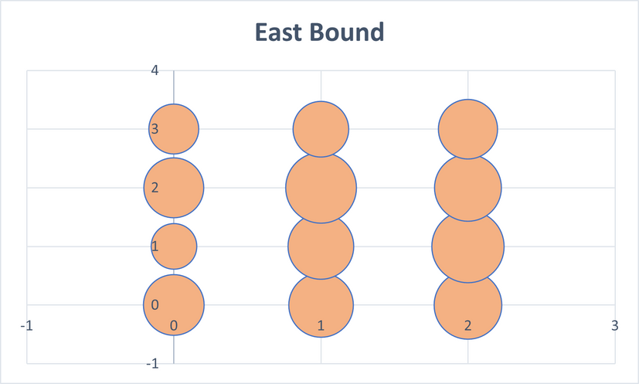
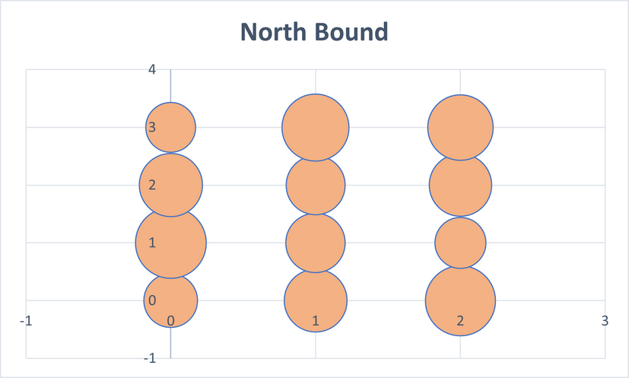
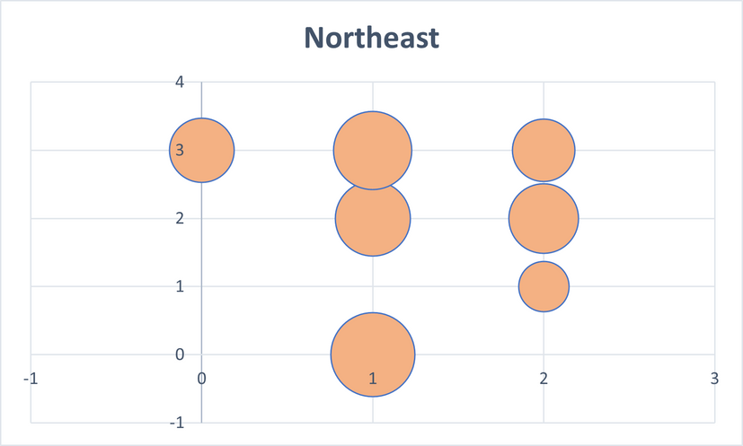
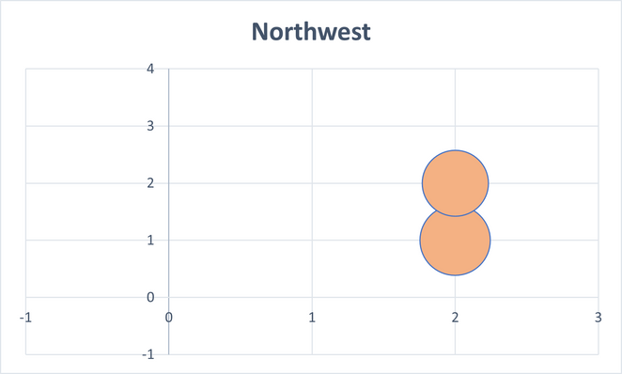
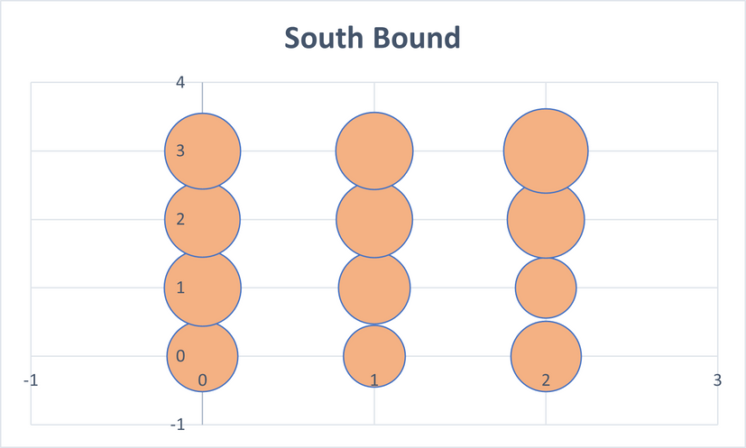
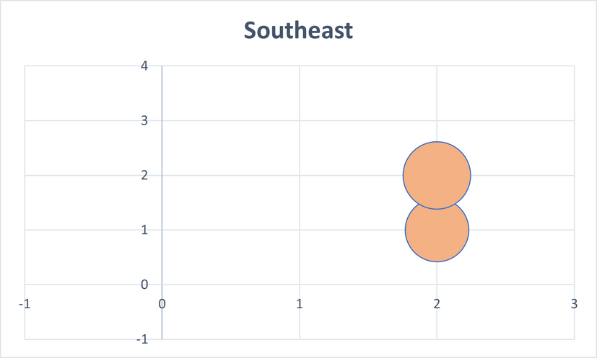
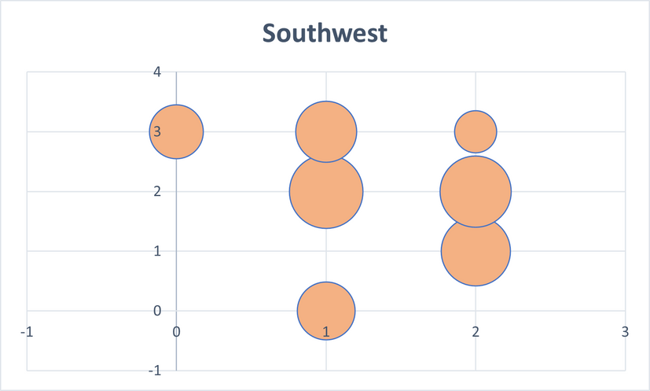
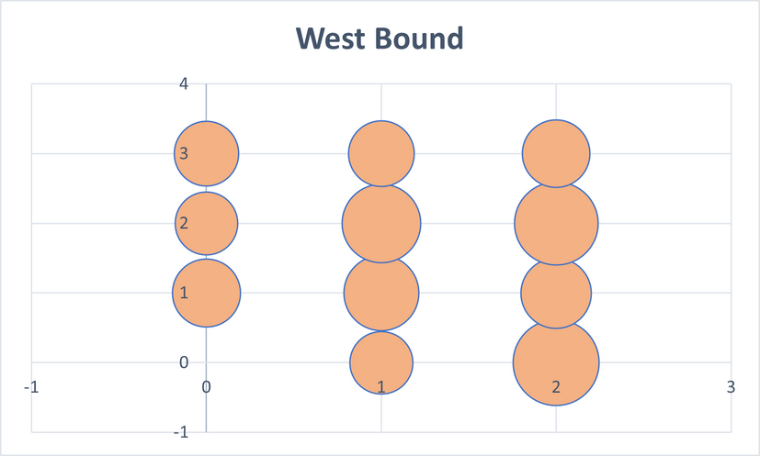
BUBBLE CHARTS

Slide 10
2
DATA UNDERSTANDING

Slide 11
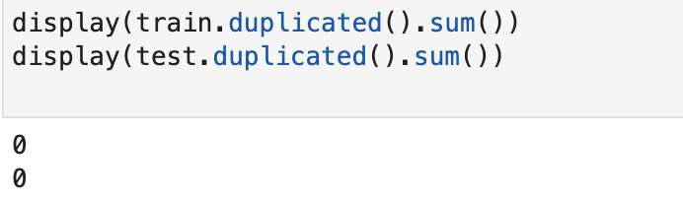
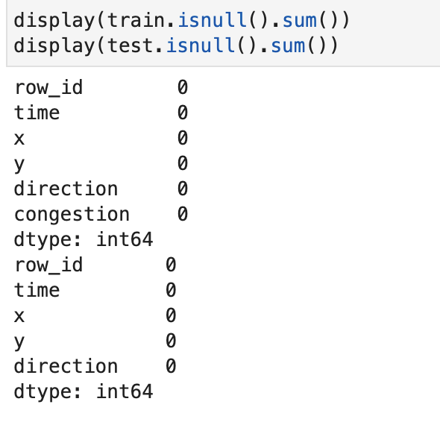
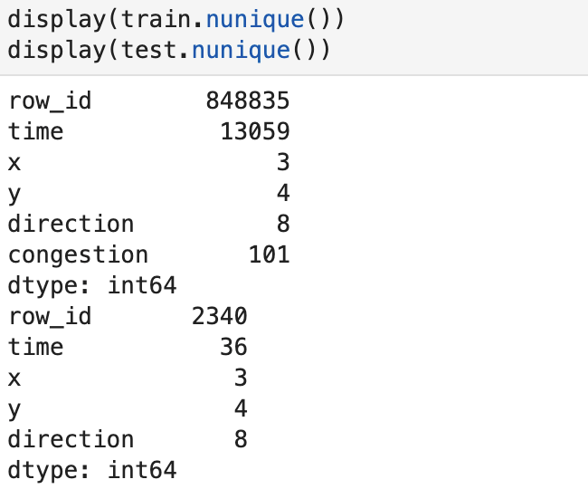
Validate
Train
data
Check the duplicate data
Check the missing data
Check the unique values of each column

Slide 12
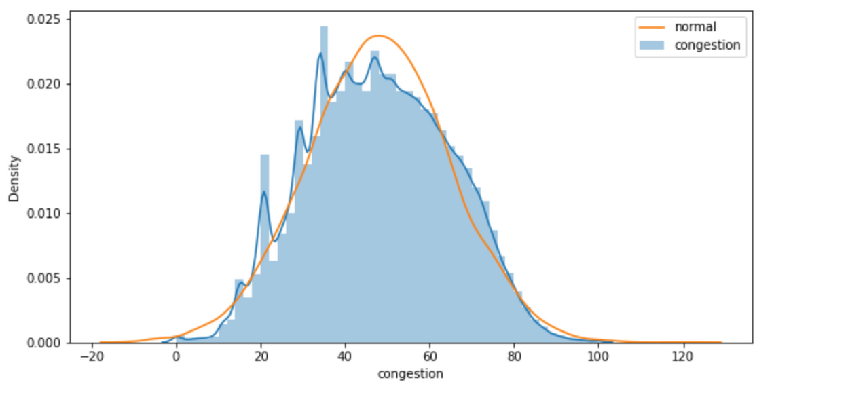
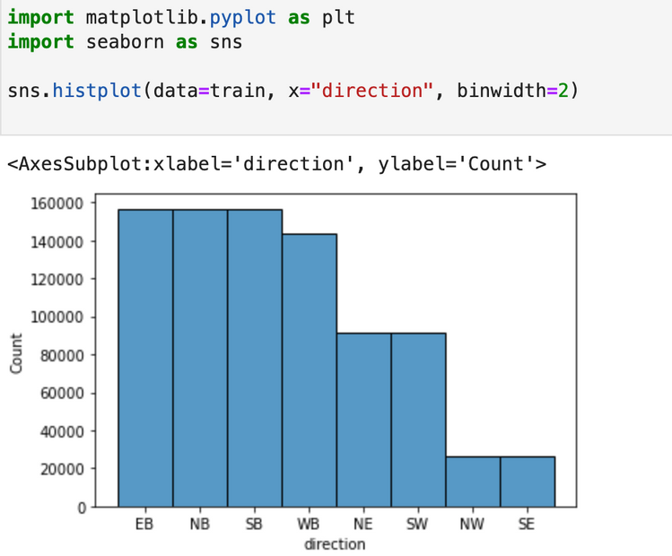
CHECK THE DISTRIBUTION OF EACH COLUMN
EB, NB, SB, these three directions have the most rows
The distribution of Congestion columns is basically normal distribution(the yellow line is the normal distribution line)

Slide 13
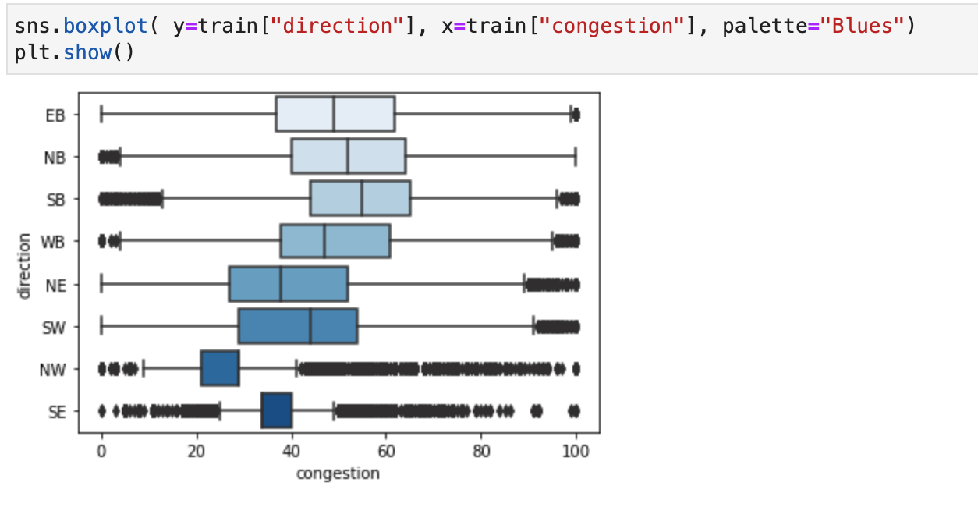
CHECK THE OUTLIERS
The EB data have a great distribution, most of them are near the median
Other seven types of directions data about congestion are not ideal. too big or too small (larger than Q3+1.5IQR, less than Q1-1.5IQR)

Slide 14
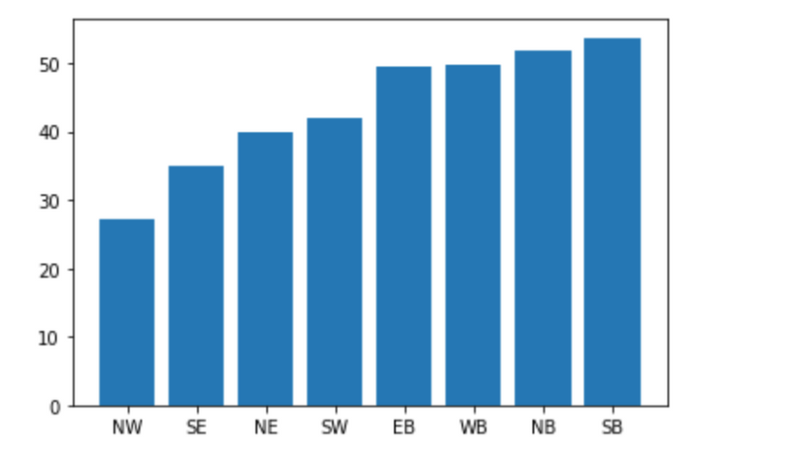
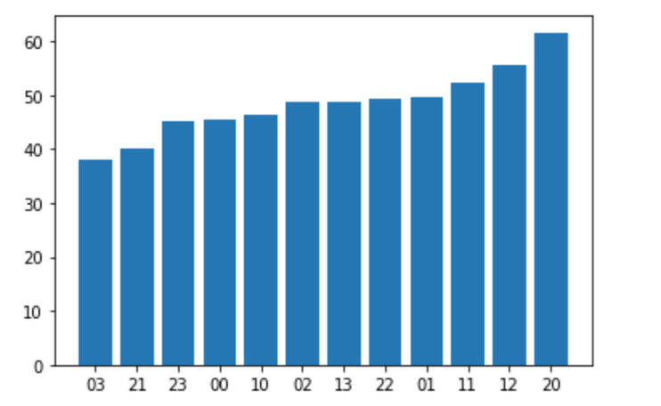
VISUALIZATION
Congestion ranked by direction
Congestion ranked by location
The congestion in SB direction is the biggest, the mean value is 53.7
The congestion in (2,0) location is the biggest, the mean value is 61.7

Slide 15
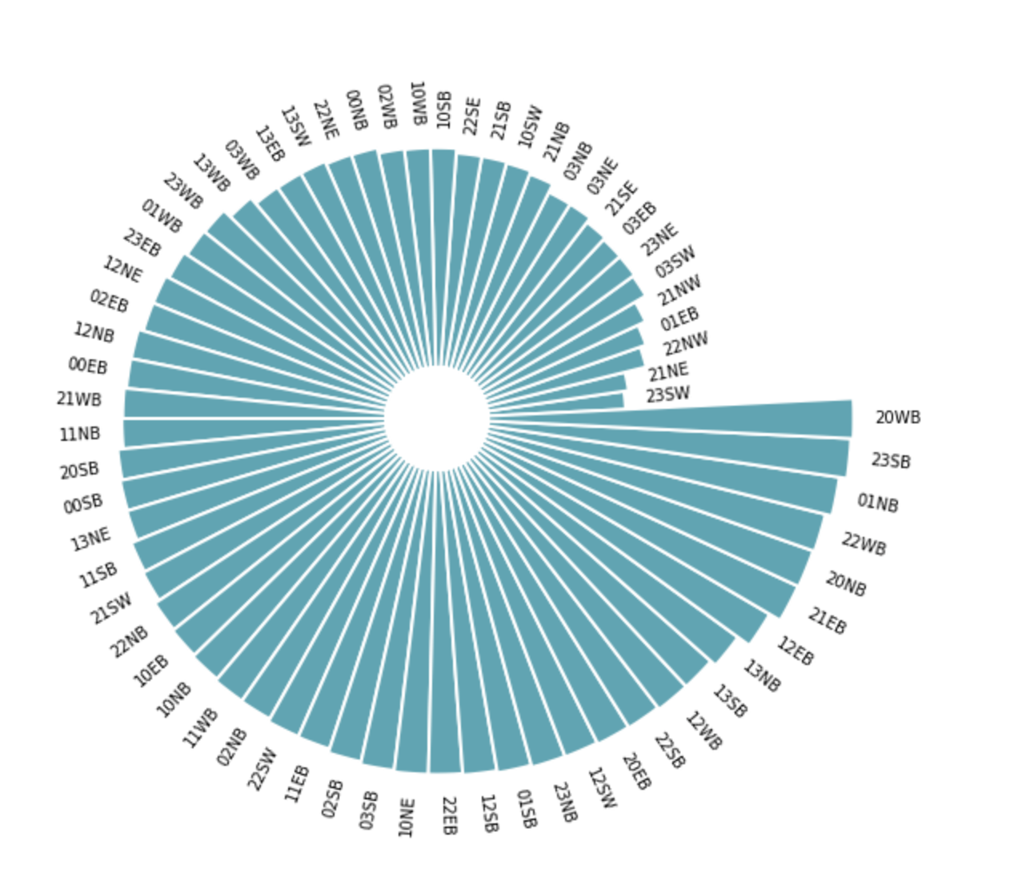
VISUALIZATION
Group by direction and location, we use Circular Barplot to visualize data
In WB direction and (2,0) direction, we have the most severe congestion

Slide 16
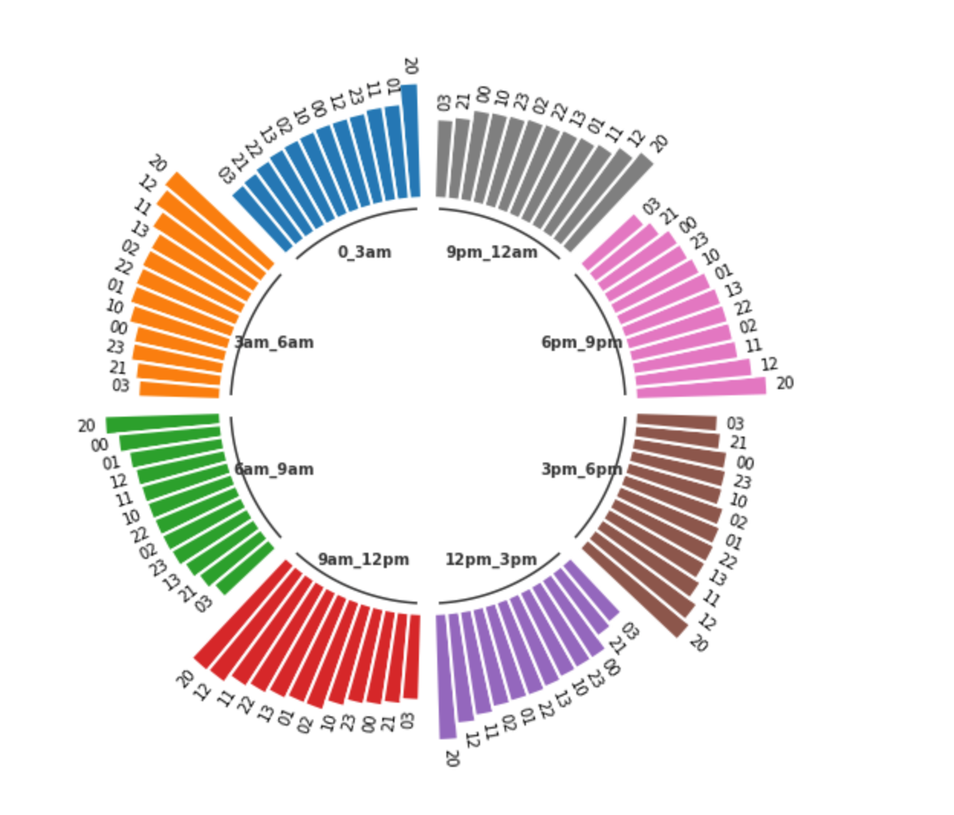
VISUALIZATION
Divide the time into 8 groups and calculate the congestion in different location
Discoveries:
In every time slot, (2, 0) location has the most congestion
Amony all time slots, 12pm-3pm, 3pm-6pm, 6pm=9pm, have the most congestions and they are 622, 650, 614

Slide 17
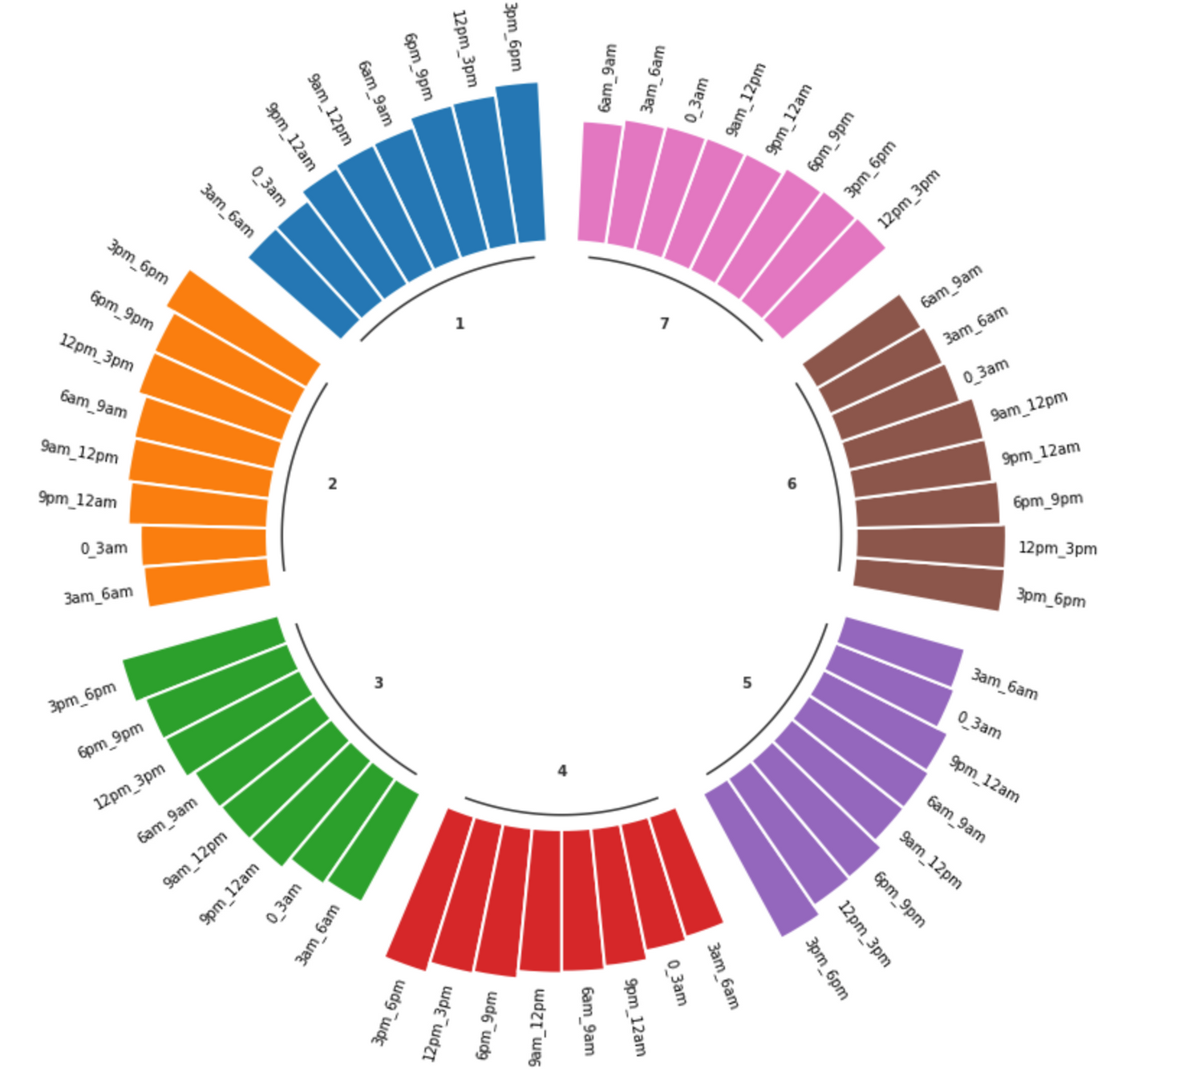
VISUALIZATION
Keep study the relationship between weekday, time slot and congestion
Discoveries:
At week day, the biggest congestion appears at 3pm-6pm; at weekend, the biggest congestion appears at 3pm-6pm or 12pm-3pm. make sense
Amony all week days, Friday has the biggest congestion, 392(hurry to come to home)

Slide 18

3
DATA PREPARATION & MODELING

Slide 19


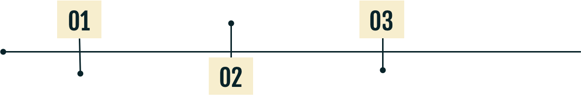

MODELING PROCESS
2.OPTIMIZATION
Feature selection
Algorithm selection
Hyperparameter tuning
3.EVALUATION
1.DATA PREPARATION
Cross validation
Mean square error
Encode categorical columns
Create new useful feature
Drop useless columns
Find the Onehot columns

Slide 20
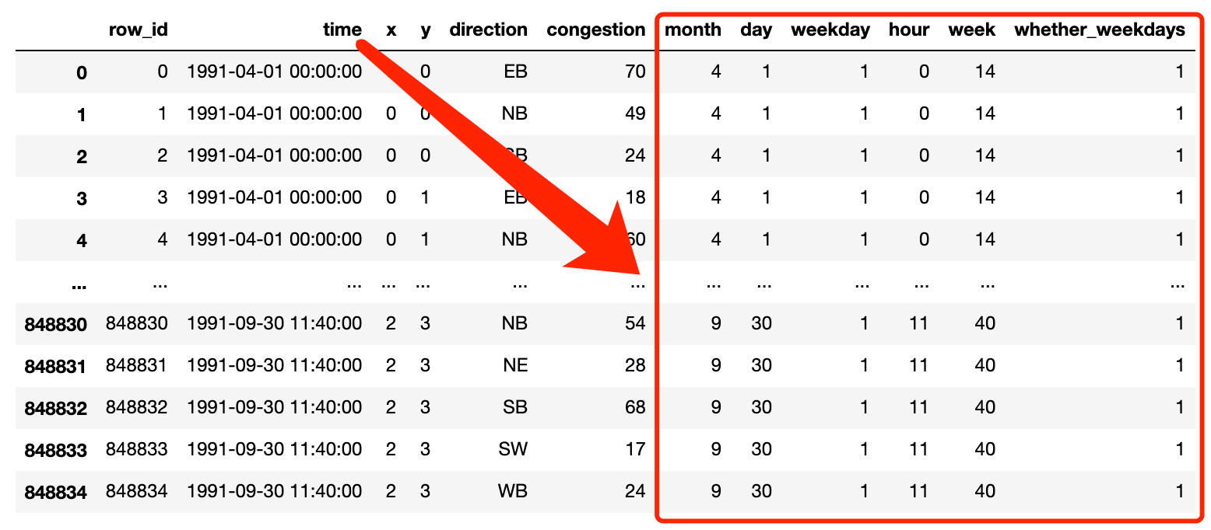
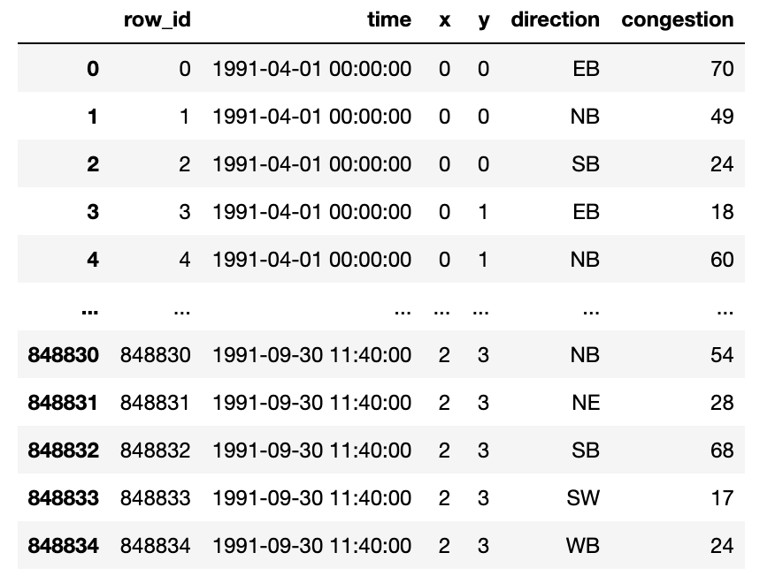
DATA PREPARATION
(BEFORE ENCODING)
45%

Slide 21
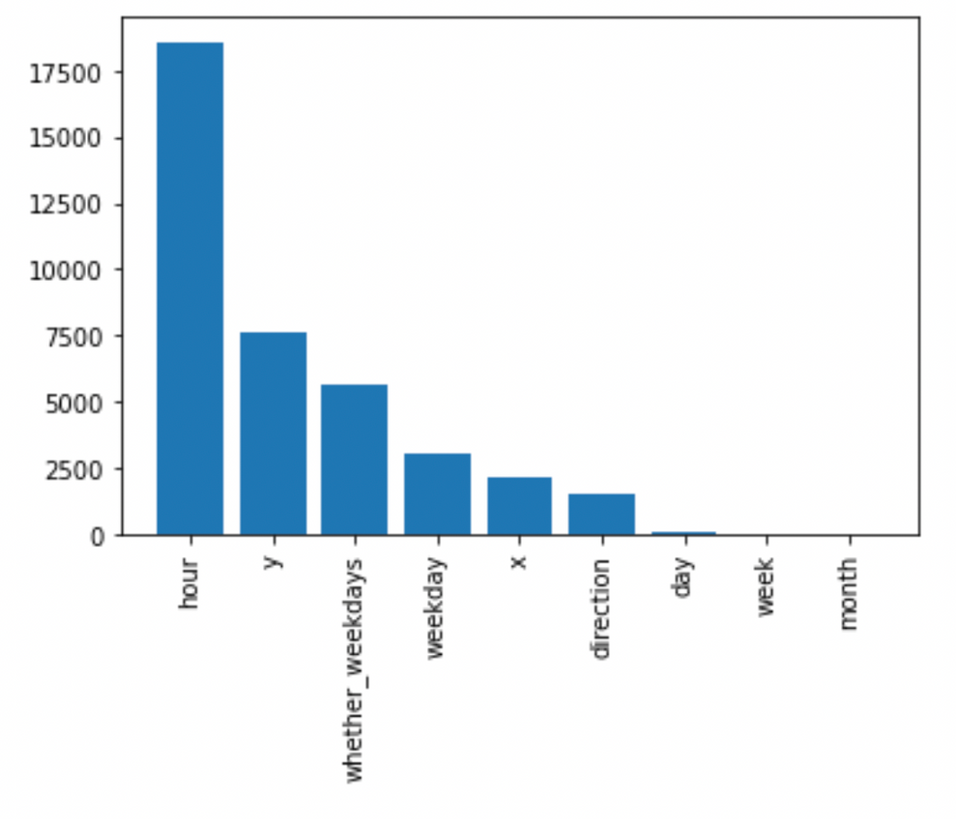
FEATURE SELECTION
'Hour' has the highest feature-score
'Week' & 'Month' have less contribution to the model predictions
Features we are going to use:
x, y, direction
hour, weekday, day, whether_weekday
Onehot columns:
x, y, direction

Slide 22
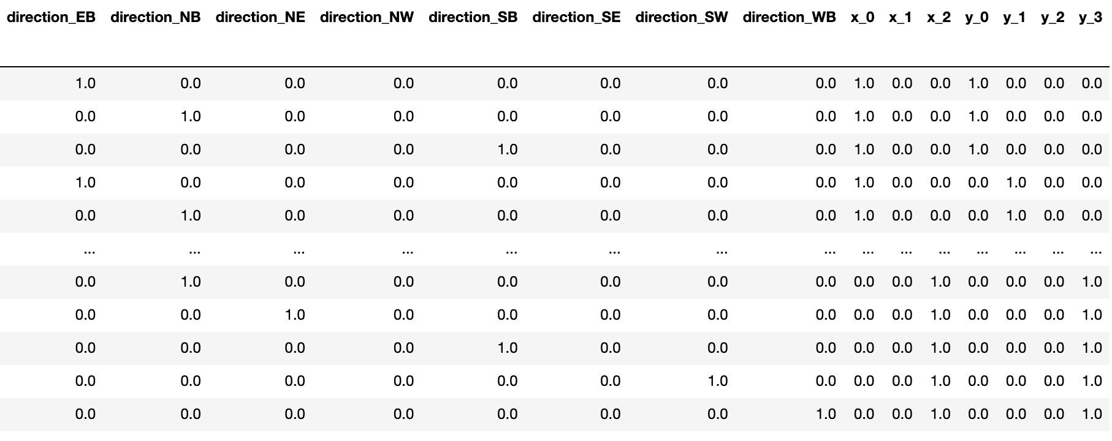
DATA PREPARATION
(AFTER ENCODING)
45%

Slide 23
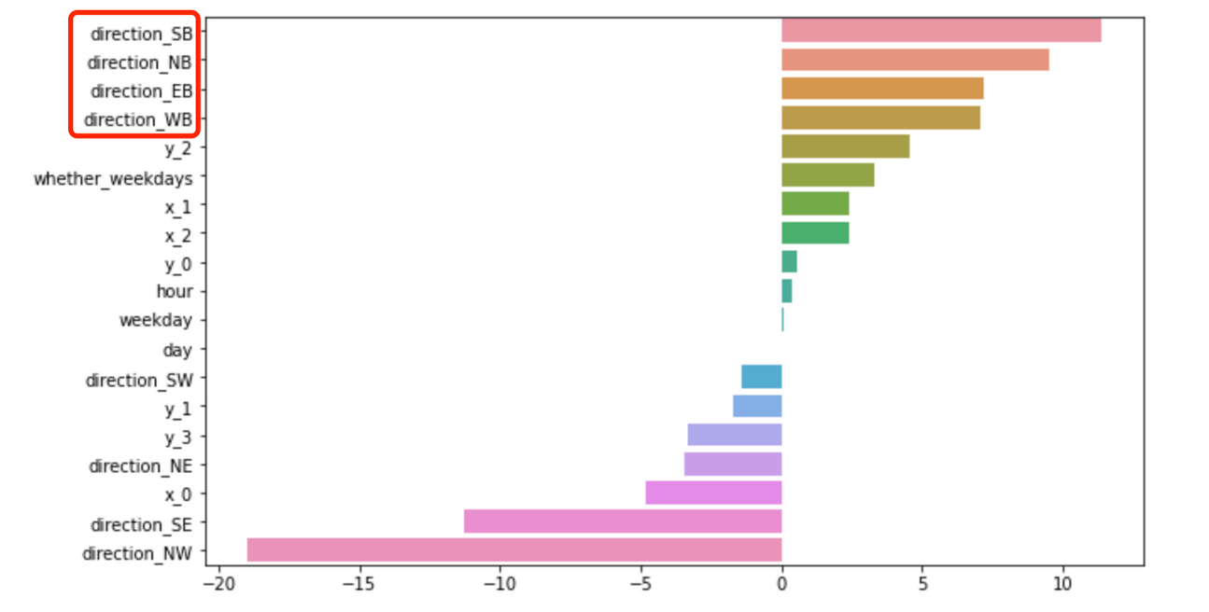
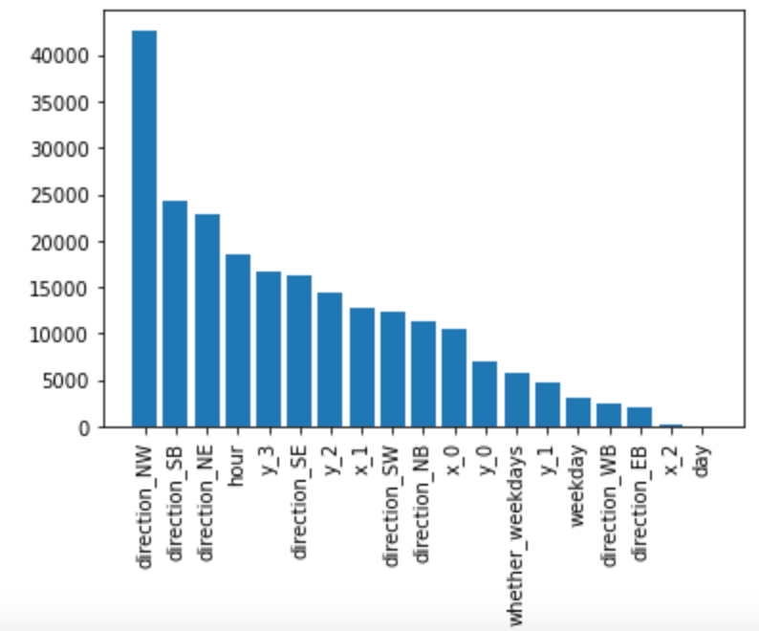
RIDGE COEFFICIENT & FEATURE SCORE
"Cardinal Directions (e.g. EastBound) have a relatively higher congestion level than ordinal directions (e.g. NotrhEast)"

Slide 24

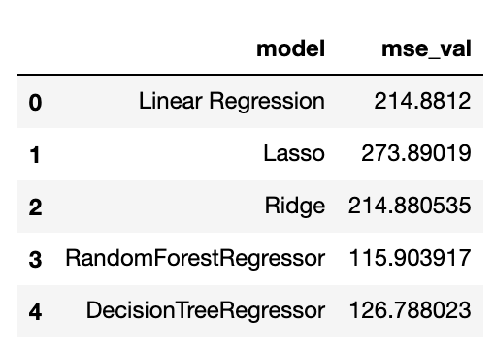
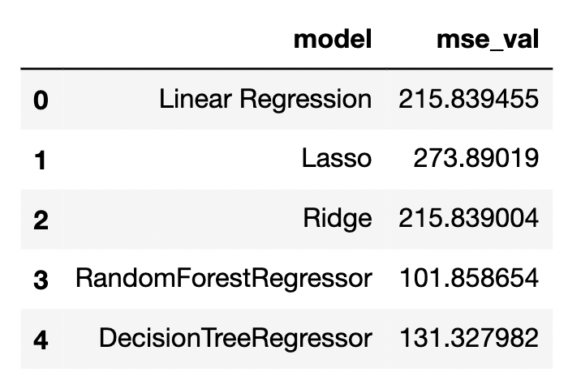
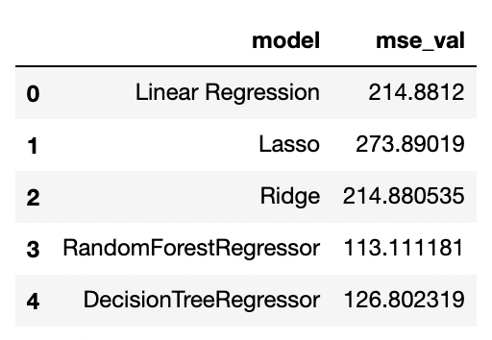
ALGORITHM SELECTION
Cross-validation
CV = 3
All models are using default hyperparameters

Slide 25
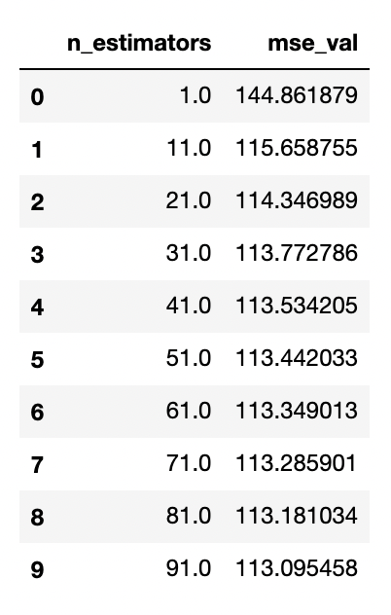
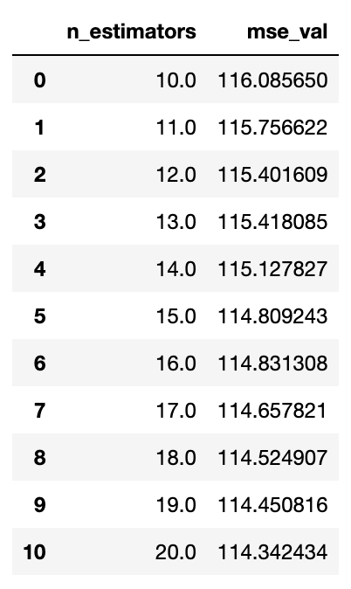
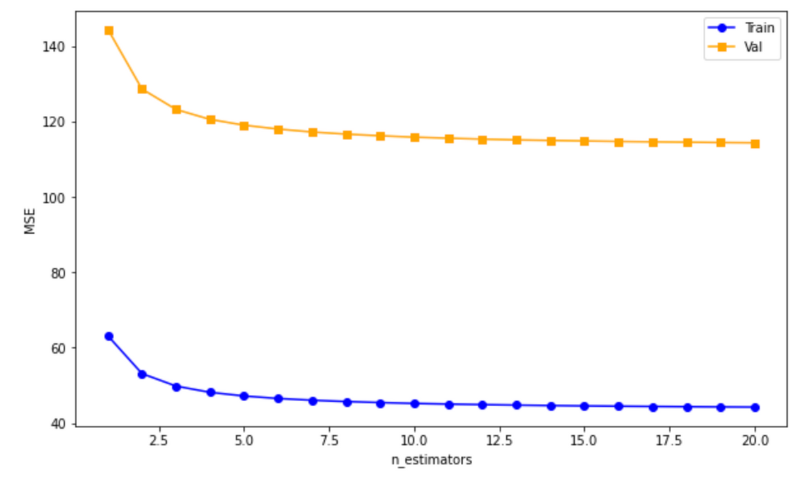
HYPERPARAMETER SELECTION
Range: 1-100
Interval: 10
Range: 10-20
Interval: 1
Validation Curve

Slide 26

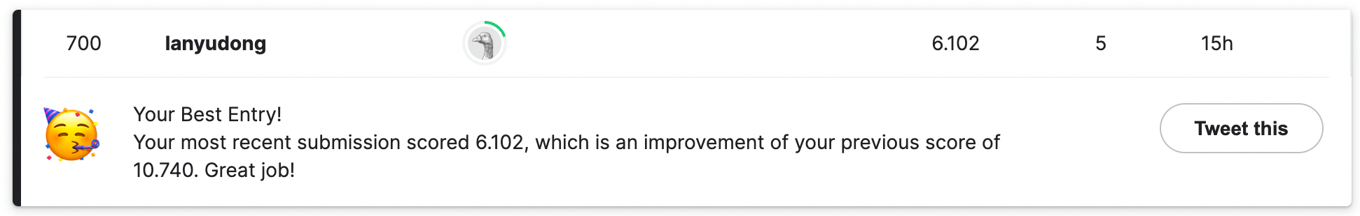

EVALUATION
MSE ON KAGGLE

Slide 27
THANKS FOR
LISTENING!

Slide 28
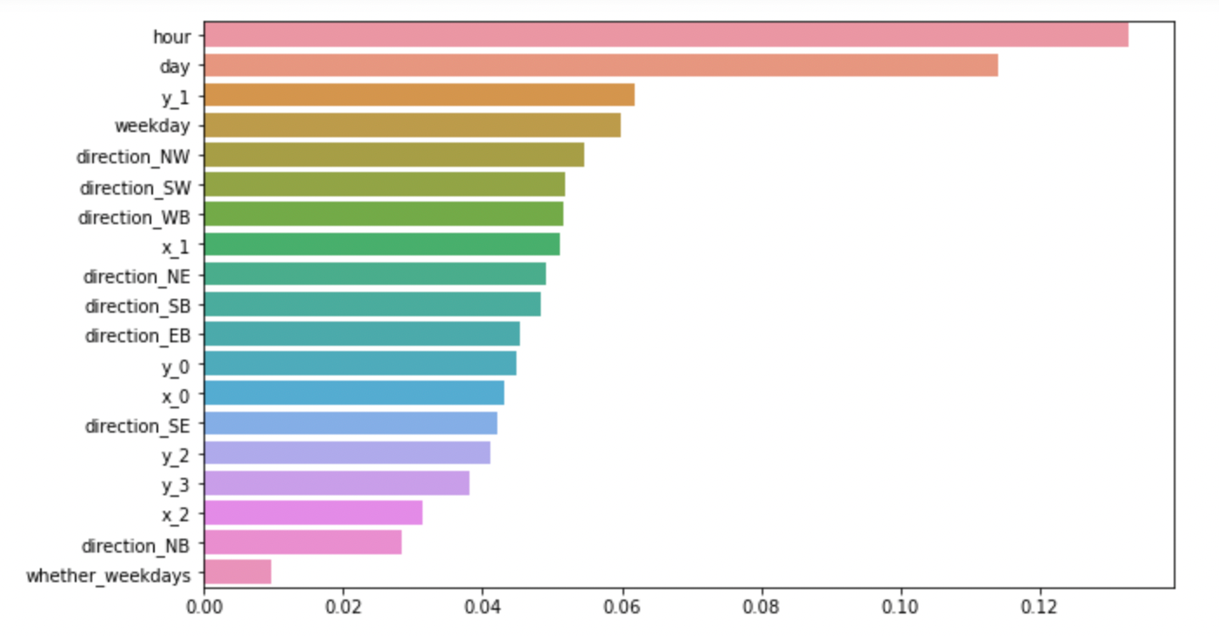

Slide 29
